Slide 1

BANK LOAN OF CUSTOMERS

Slide 2

PROJECT OBJECTIVE
This is Bank Loan of Customers Project ; we are provided with two datasets ‘finance1’ and ‘finance2’ with .csv and .xlsx extension.
Each file is having more than 39k records and the objective was to analyze the growth that bank got within given years in loans.
We used MS-Excel , MySQL, Tableau and Power BI for analyzing and organizing the data in such a way that meaningful conclusions can be drawn from them and Prepared KPI’s .Where we did calculations ,merging and Prepared interactive Dashboards.

Slide 3

KPI’s
Year wise Loan amount Status
Grade and Sub grade wise revol_bal
Total Payment for Verified Status Vs Total Payment for Non-Verified Status
State wise and last_credit_pull_d wise loan status
Home ownership Vs Last payment date status

Slide 4
MODULES
EXCEL
SQL
TABLEAU
POWER BI

Slide 5
KPI 1
Sum of loan_amnt trended up, resulting in a 11,638.36% increase between 2007 and 2011.
﻿Sum of loan_amnt started trending up on 2007, rising by 11,638.36% (258287300) in 4 years.
Sum of loan_amnt jumped from 2.2M to 260.51M during its steepest incline between 2007 and 2011.﻿

Slide 6
KPI 2
B in sub_grade B3 made up 7.47% of Sum of revol_bal.
Sum_of revol_bal for only B grade is 161.31M
Grand total of revol_bal is 531.51M

Slide 7
KPI 3
Sum of total_pymnt for Verified (219.89M) was higher than Not- Verified (153.54M).
﻿Verified accounted for 58.88% of Sum of total_pymnt.
The sum of total_pymnt for verified and not verified is 373.43M

Slide 8
KPI 4
Count of last_credit_pull_d | loan_status
addr_state | Charged Off | Current | Fully Paid
AK | 15 | 2 | 63
AL | 54 | 17 | 381
AR | 27 | 10 | 208
AZ | 123 | 30 | 726
CA | 1124 | 150 | 5823
CO | 98 | 26 | 668
CT | 94 | 25 | 632
DC | 15 | 3 | 196
DE | 12 | 1 | 101
FL | 504 | 85 | 2277
GA | 215 | 39 | 1144
HI | 28 | 8 | 138
IA |  |  | 5
ID | 1 |  | 5
IL | 197 | 47 | 1281
IN |  |  | 9
KS | 31 | 16 | 224
KY | 45 | 14 | 266
LA | 53 | 9 | 374
MA | 159 | 43 | 1138
MD | 162 | 26 | 861
ME |  |  | 3
MI | 103 | 16 | 601
MN | 81 | 10 | 524
MO | 114 | 16 | 556
MS | 2 |  | 17
MT | 11 | 2 | 72
NC | 114 | 38 | 636
NE | 3 |  | 2
NH | 25 | 5 | 141
NJ | 278 | 60 | 1512
NM | 30 | 6 | 153
NV | 108 | 18 | 371
NY | 495 | 114 | 3203
OH | 155 | 45 | 1023
OK | 40 | 12 | 247
OR | 71 | 16 | 364
PA | 180 | 49 | 1288
RI | 25 | 4 | 169
SC | 66 | 13 | 393 50
SD | 12 | 2
TN | 2 |  | 15
TX | 316 | 68 | 2343
UT | 40 | 6 | 212
VA | 177 | 38 | 1192
VT | 6 | 1 | 47
WA | 127 | 22 | 691
WI | 63 | 20 | 377
WV | 21 | 5 | 151
WY | 4 | 3 | 76
State wise and last_credit_pull_d wise loan status

Slide 9
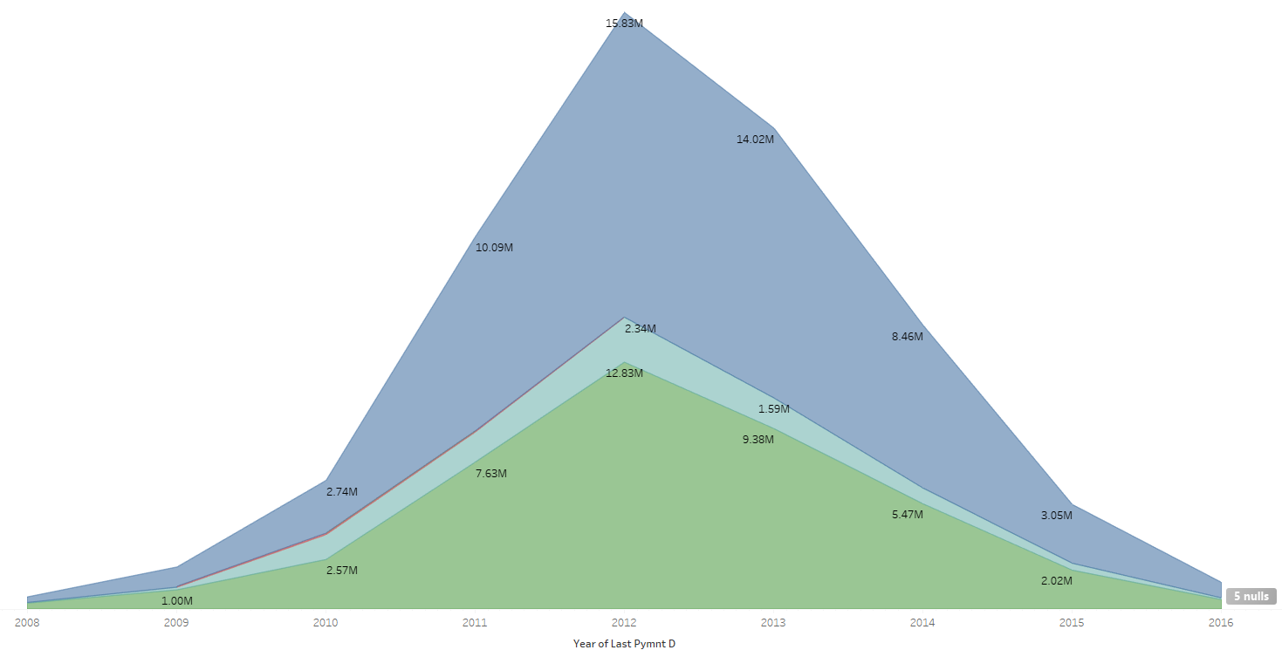
KPI 5
﻿Between 2008 and 2016, MORTGAGE had the largest increase in Sum of last_pymnt_amnt (179.49%) while OTHER had the largest decrease (98.67%).
﻿Across home_ownership, OWN had the most interesting recent trend and started trending down on 2012, falling by 96.22% (22,47,972.16) in 4 years.

Slide 10
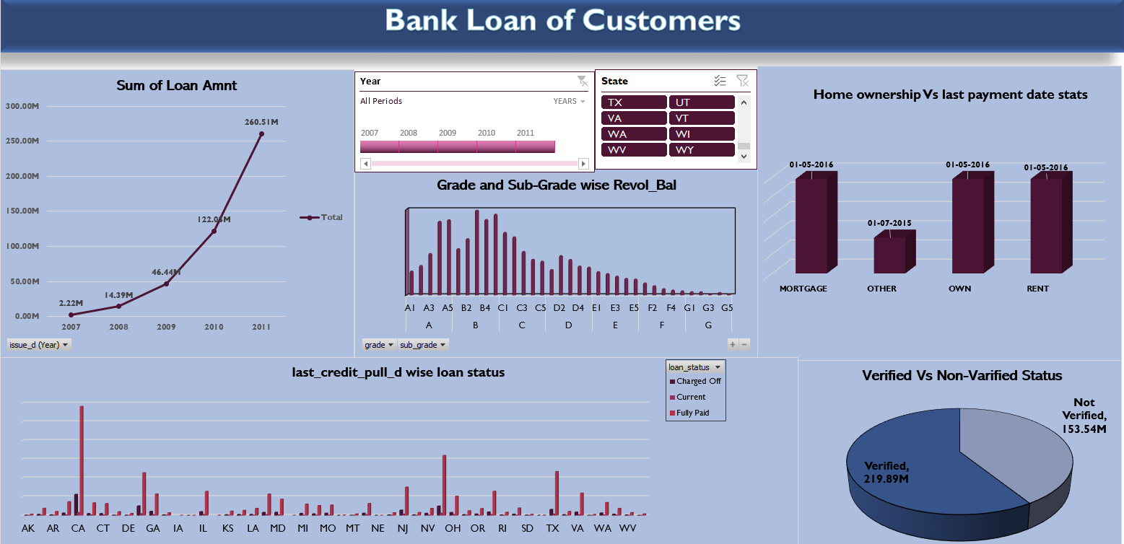
DASHBOARD OF EXCEL

Slide 11
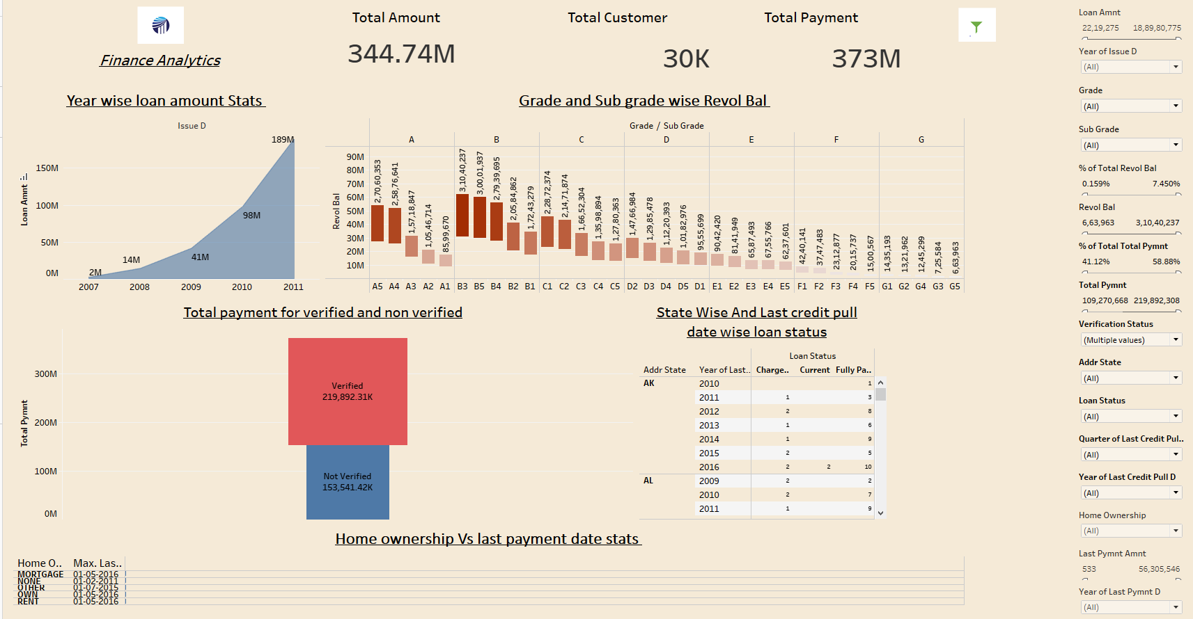
DASHBOARD OF TABLEAU

Slide 12
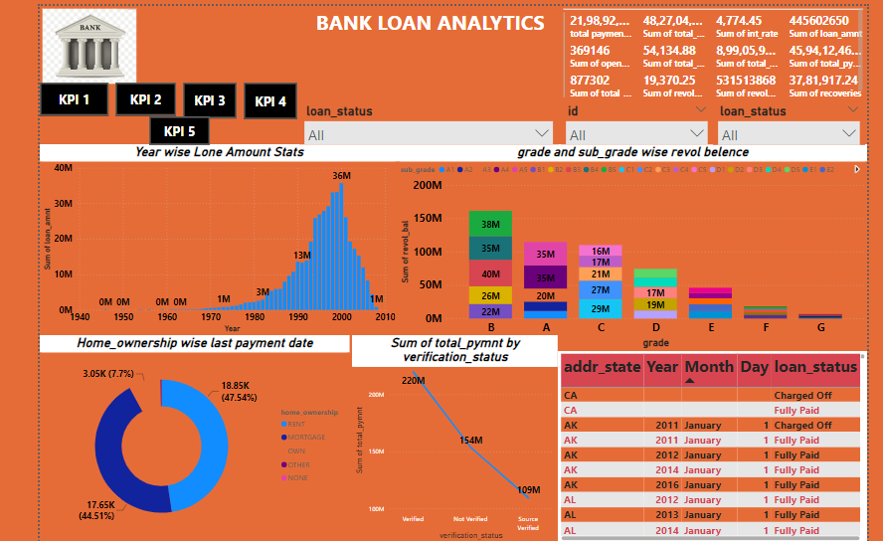
DASHBOARD OF POWERBI

Slide 13
THANK YOU

